Slide 1

DevOps with Kubernetes
An Introduction
Kumaran Confidential Information. Not to be circulated

Slide 2
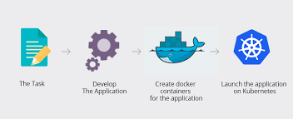
Scope

Slide 3
Streams
JAVA
2. .NET Core

Slide 4
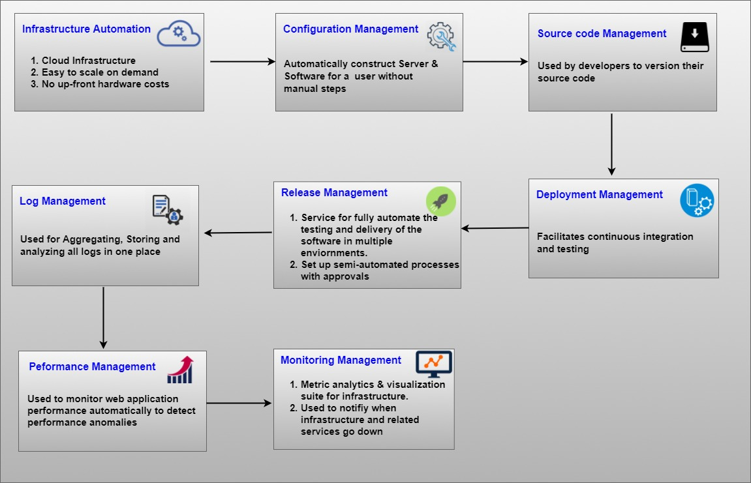
Phases

Slide 5
Challenges of microservices or why Kubernetes?
Availability
Application might composes of N number of micro services . How to monitor all these microservices of their availability?
Automatic Scaling
How can we scale specific set of microservices to scale depending on the usage of those microservices?
Service Discovery
There could be multiple instances of those microservices running in the cluster, how to discover those microservices to get connect to from the application point of view?
Security
Docker containers can expose ports and all accessible from everywhere, how to control those access?
Cloud Portability
Applications can completely portable to on premises or other cloud. No vendor lock-in
Debugging
How to monitor the application when it ran into problems?

Slide 6
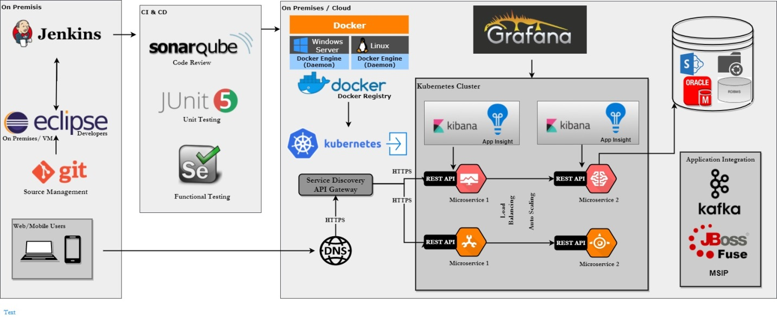
Java Implementation Architecture

Slide 7
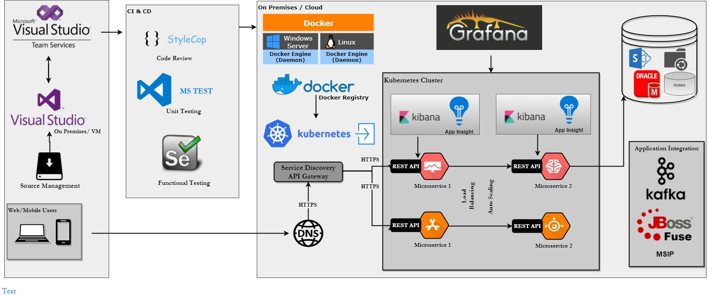
.Net Implementation Architecture

Slide 8
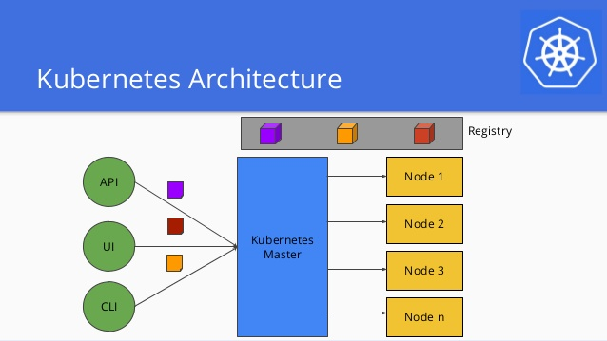
Kubernetes Architecture – Over Simplified

Slide 9
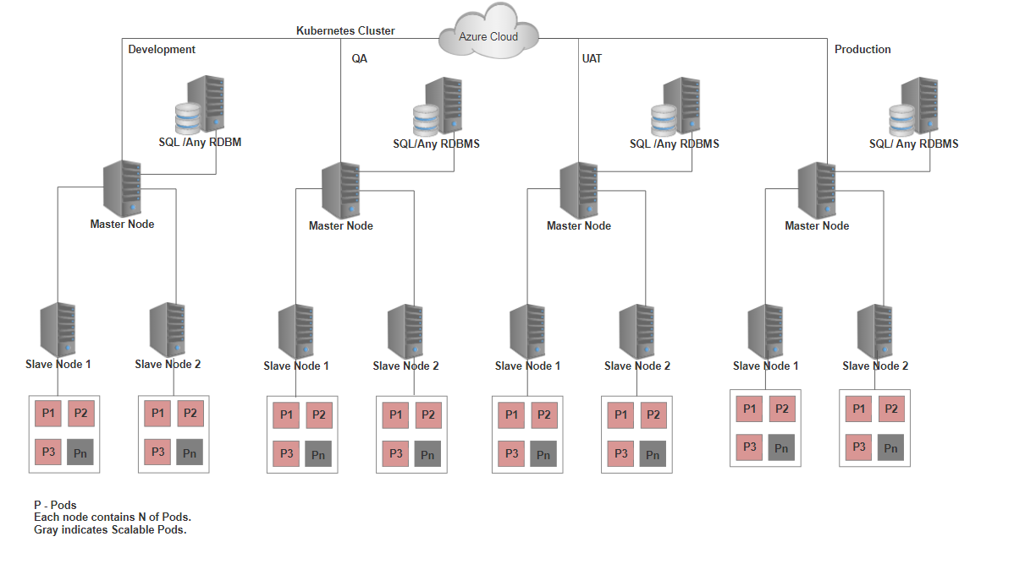
Deployment Architecture

Slide 10
Tools
 | .Net |  | Java
Category | Tools | License | Tools | License
Source Code IDE | Visual Studio 2017 | Microsoft Licensed | Eclipse | Open Source
Source Repository | Git | Open Source | GitLab Repository | Free for On-Premises
CICD Tool | VSTS | Microsoft Azure Licensed | Jenkins | Open Source
Unit Test Tools | Microsoft Unit Test | Microsoft Azure Licensed | JUnit | Open Source
Static Code Analyzer Tools | StyleCop | Open Source | SonarQube | Open Source
Container Tools | Dockers | Open Source | Dockers | Open Source
Functional Testing Tools | Selenium | Apache Licensed | Selenium | Apache Licensed
Issue Tracking Tools | VSTS Work Item | Microsoft Azure Licensed | Jira | Atlassian Licensed
API Gateway | Ocelot | Open Source | Zuul | Open Source
Docker Registry | Azure Container Registry | Microsoft Azure Licensed | Azure Container Registry | Microsoft Azure Licensed
Container Services | Azure Container Services | Microsoft Azure Licensed | Azure Container Services | Microsoft Azure Licensed
Cluster Nodes | Container VMs | Microsoft Azure Licensed | Nodes-Container VMs | Microsoft Azure Licensed
On Prem/Cloud DB | SQL Server | Microsoft Licensed | SQL Server | Microsoft Licensed
Data visualization Tools | Kibana | Open Source | Kibana | Open Source
Server Monitoring Tool | Grafana | Open Source | Grafana | Open Source
Application Monitoring Tools | Application Insights | Microsoft Azure Licensed | Application Insights | Microsoft Azure Licensed

Slide 11
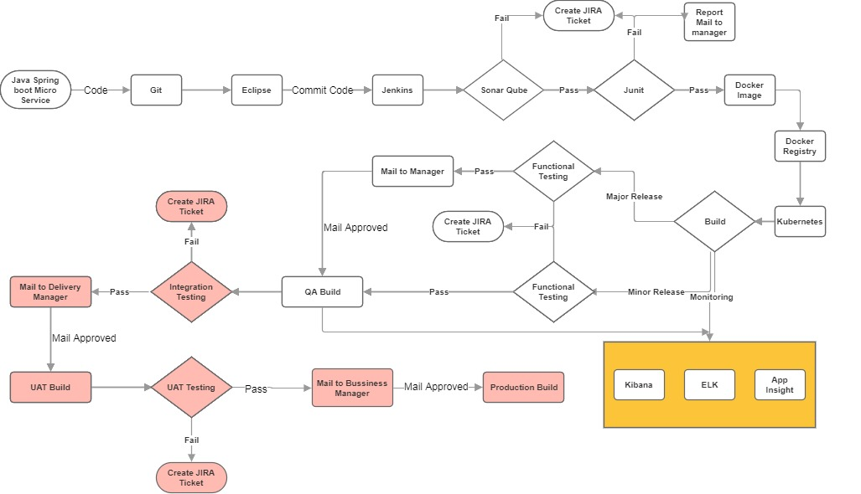
Java – Process Flow

Slide 12
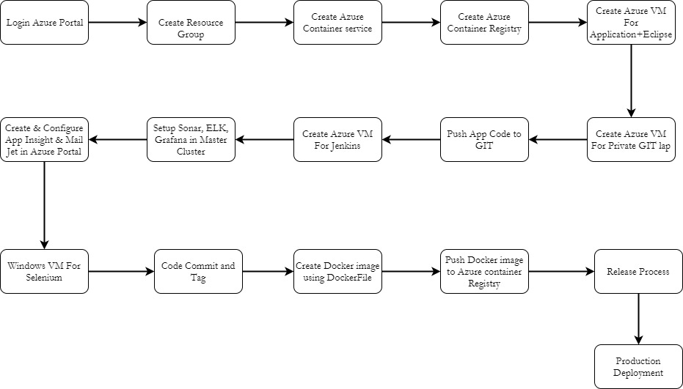
Java – Environment Setup Flow

Slide 13
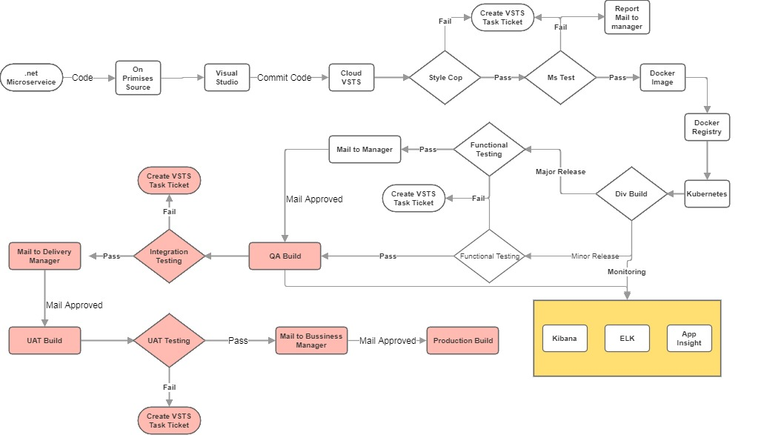
.NET – Process Flow

Slide 14
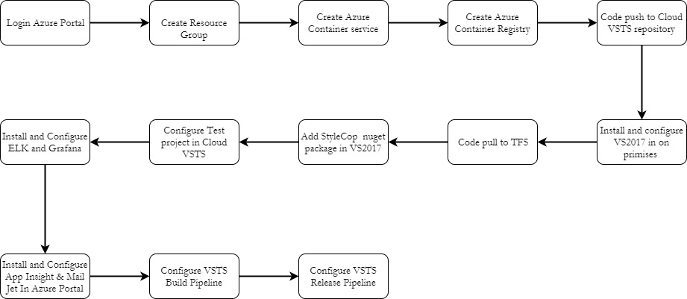
.NET – Environment Setup Flow

Slide 15
Why Dockers
Light weight
Docker is light weight compared to the VMs
Portable
Docker is hardware agnostics, Cloud agnostics, Platform agnostics, Language agnostics
Reusable Layers
Layers of Docker containers are shared
CI/CD
Completely supports Continuous Integration and Continuous Delivery models
Why Kubernetes
Open Source
Open source system for deploying, scaling and managing containerized applications.
Portable
Support for Public, Private, Hybrid and Multi Cloud deployment models.
Scaling
Automatically scales the number of pods based on CPU utilization
App Support & Tools
Support spectrum of languages including .Net, .Net Core, Java, Ruby and more. Support larger community of third party tools.

Slide 16
Kubernetes Vs Openshift
Kubernets | OpenShift
Open source | Red Hat license
Provides the simplicity of PaaS with the flexibility of IaaS. | Red Hat Openshift is a Platform as a Service that is built on Docker and Kubernetes.
Metrics, loggings, build and deployment automation, optionally done using Jenkins | Metrics, loggings, build and deployment automation are come out of the box with Openshift.
No Vendor lock in | Vendor lock in so that users cannot easily migrate many of the services
Service availability at owners risk. Can have control. | Service availability can be a concern with PaaS. If a provider experiences a service outage this can adversely affect customers.
More configuration & development time required for orchestration | Better developer experience

Slide 17
Thank you

